Slide 1
EDA USING TABLEAU
O.Uttej Reddy

Slide 2
AGENDA
Abstract
Introduction
Literature Survey
Technology
Results
Conclusion

Slide 3
ABSTRACT
A Tableau dashboard which is based on Netflix’s dataset over the past few decades.
This dashboard is useful to analyse raw data and layout various graphical representations to understand the data better.
This dashboard lets the viewer to compare a variety of data simultaneously.
A simple dashboard which can be easily understood by everyone via various graphs and pie charts.

Slide 4
INTRODUCTION
This Dashboard represents the raw data in the form of simple graphical representations.
Some of these graphical representations are pie charts, maps, tree maps, horizontal bars, list etc.
These graphical representations make the data simpler and easily readable.

Slide 5
Literature Survey
This dashboard helps the viewer to compare between various TV shows and movies over the past few decades and choose among them.
Viewer also gets an insight of the top TV shows and Movies in Netflix.
Viewer can choose between shows according to his/her preferences such as, genre, based on directors, country/region.

Slide 6

Technology
Tableau is a leading data visualization tool used for data analysis and business intelligence.

Slide 7
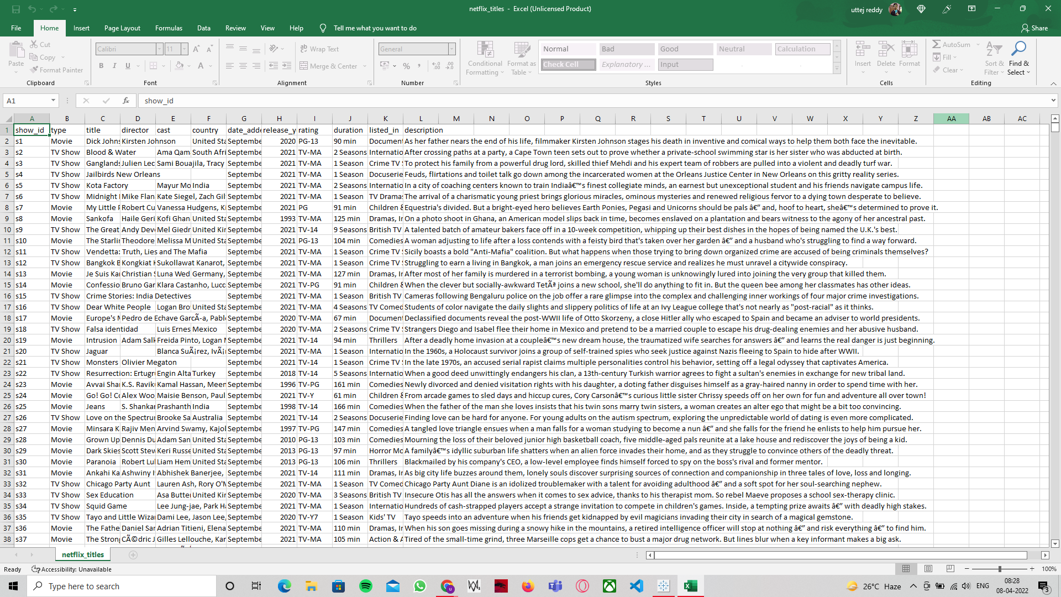
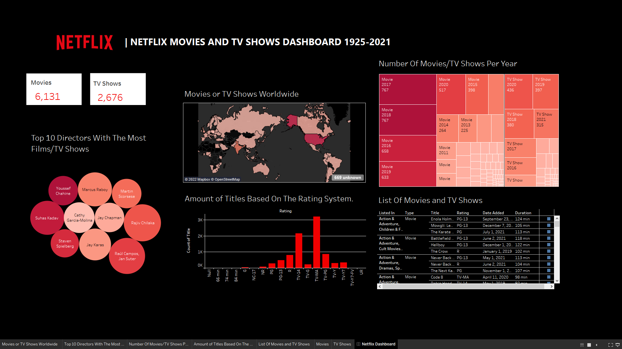
RESULT
Input Output
Raw data of Netflix
Dashboard using Tableau

Slide 8
CONCLUSION
Tableau is a very effective tool for graphical representation, and it has more than 24 different graphical views to display data.
Though the dataset is complex or the dataset is very big, in tableau, we can create dashboards very easily and within less time.

